Slide 1
Non Deterministic Finite Automata

Slide 2
Non-deterministic Finite Automata (NFA)
A Non-deterministic Finite Automaton (NFA)
is of course “non-deterministic”
Implying that the machine can exist in more than one state at the same time
Transitions could be non-deterministic
1
q_{j}
q_{i}
…
Each transition function therefore maps to a set of states
1
q_{k}

Slide 3
Non-deterministic Finite Automata (NFA)
A Non-deterministic Finite Automaton (NFA) consists of:
Q ==> a finite set of states
∑ ==> a finite set of input symbols (alphabet)
q₀ ==> a start state
F ==> set of accepting states
δ ==> a transition function, which is a mapping between Q x ∑ ==> subset of Q
An NFA is also defined by the 5-tuple:
{Q, ∑ , q₀,F, δ }

Slide 4
How to use an NFA?
Input: a word w in ∑*
Question: Is w acceptable by the NFA?
Steps:
Start at the “start state” q₀
For every input symbol in the sequence w do
Determine all possible next states from all current states, given the current input symbol in w and the transition function
If after all symbols in w are consumed and if at least one of the current states is a final state then accept w;
Otherwise, reject w.

Slide 5
NFA for strings containing 01
Why is this non-deterministic?
Q = {q₀,q₁,q₂}
Σ = {0,1}
start state = q₀
F = {q₂}
Transition table
0,1
0,1
start
0
1
q₀
q₁
q₂
Final
state
symbols
0
1
q₀
{q₀,q₁}
{q₀}
states
q₁
Φ
{q₂}
What will happen if at state q₁ an input of 0 is received?
*q₂
{q₂}
{q₂}

Slide 6
What is an “error state”?
Note: Omitting to explicitly show error states is just a matter of design convenience (one that is generally followed for NFAs), and i.e., this feature should not be confused with the notion of non-determinism.
A DFA for recognizing the key word “while”
An NFA for the same purpose:
w
h
i
l
e
q₀
q₁
q₂
q₃
q₄
q₅
Any other input symbol
q_{err}
Any symbol
w
h
i
l
e
q₀
q₁
q₂
q₃
q₄
q₅
Transitions into a dead state are implicit

Slide 7
Example #2
Build an NFA for the following language: L = { w | w ends in 01}
Other examples
Keyword recognizer (e.g., if, then, else, while, for, include, etc.)
Strings where the first symbol is present somewhere later on at least once

Slide 8
Differences: DFA vs. NFA
But, DFAs and NFAs are equivalent in their power to capture langauges !!
DFA
All transitions are deterministic
Each transition leads to exactly one state
For each state, transition on all possible symbols (alphabet) should be defined
Accepts input if the last state visited is in F
Sometimes harder to construct because of the number of states
Practical implementation is feasible
NFA
Some transitions could be non-deterministic
A transition could lead to a subset of states
Not all symbol transitions need to be defined explicitly (if undefined will go to an error state – this is just a design convenience, not to be confused with “non-determinism”)
Accepts input if one of the last states is in F
Generally easier than a DFA to construct
Practical implementations limited but emerging (e.g., Micron automata processor)

Slide 9
Equivalence of DFA & NFA
Theorem:
A language L is accepted by a DFA if and only if it is accepted by an NFA.
Proof:
If part:
Prove by showing every NFA can be converted to an equivalent DFA (subset construction)
Only-if part is trivial:
Every DFA is a special case of an NFA where each state has exactly one transition for every input symbol. Therefore, if L is accepted by a DFA, it is accepted by a corresponding NFA.

Slide 10
NFA to DFA construction: Example
Idea: To avoid enumerating all of power set, do “lazy creation of states”
L = {w | w ends in 01}
0,1
1
0
0
1
[q₀]
0
[q₀,q₁]
1
[q₀,q₂]
q₀
q₁
q₂
0
1
NFA:
DFA:
δ_{N} | 0 | 1
q₀ | {q₀,q₁} | {q₀}
q₁ | Ø | {q₂}
*q₂ | Ø | Ø
δ_{D} | 0 | 1
[q₀] | [q₀,q₁] | [q₀]
[q₀,q₁] | [q₀,q₁] | [q₀,q₂]
*[q₀,q₂] | [q₀,q₁] | [q₀]
0. Enumerate all possible subsets
Determine transitions
2. Retain only those states reachable from {q₀}

Slide 11
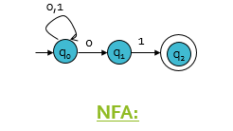
NFA to DFA: Repeating the example using LAZY CREATION
L = {w | w ends in 01}
1
0
[q₀]
0
[q₀,q₁]
1
[q₀,q₂]
0
1
DFA:
δ_{N} | 0 | 1
q₀ | {q₀,q₁} | {q₀}
q₁ | Ø | {q₂}
*q₂ | Ø | Ø
δ_{D} | 0 | 1
[q₀] | [q₀,q₁] | [q₀]
Main Idea:
Introduce states as you go
(on a need basis)

Slide 12
NFA Examples
Construct a minimal NFA accepting a set of strings over {a, b} in which each string of the language starts with ‘ab’.
Construct a minimal NFA accepting a set of strings over {a, b} in which each string of the language contain ‘a’ as the substring.
Design a NFA of all binary strings in which 2nd last bit is 1.
Construct an NFA with ∑ = {0, 1} in which a substring “double ‘1’ is followed by single ‘0’” must exist. (110)
Construct an NFA in which all the string contains a substring 1101.

Slide 13
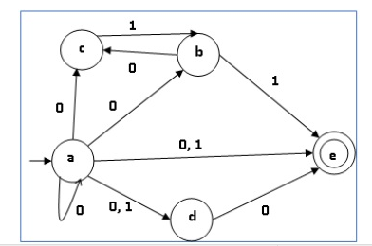
NFA TO DFA conversion

Slide 14
NFA’s with ε −Transitions
We extend the class of NFAs by allowing (ε) transitions:
The automaton may be allowed to change its state without reading the input symbol.
In diagrams, such transitions are depicted by labeling the appropriate arcs with ε.
Note that this does not mean that ε has become an input symbol. On the contrary, we assume that the symbol ε does not belong to any alphabet.

Slide 15
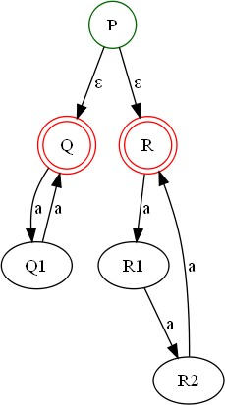
Example
{
_{a}n
| n is even or divisible by 3 }

Slide 16
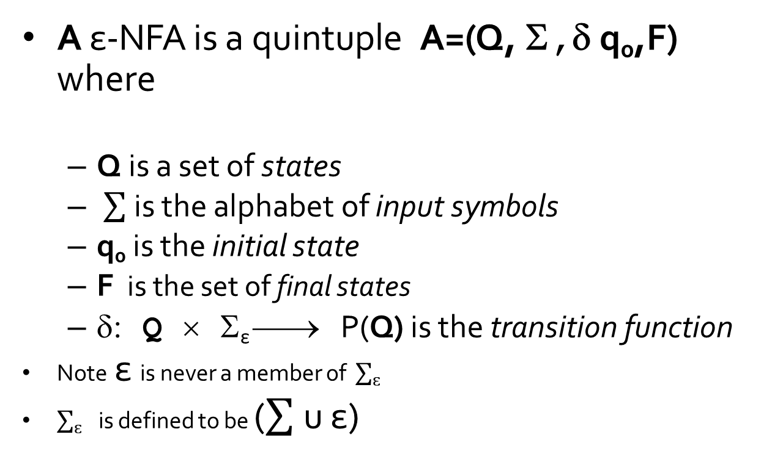
Definition
A ε-NFA is a quintuple A=(Q, Σ,δ q₀,F)
where
Q is a set of states
is the alphabet of input symbols
q₀ is the initial state
F is the set of final states
δ: Q × Σ_{ε} ⎯→ P(Q) is the transition function
Note ε is never a member of $\sum_{ɛ}{ }$
$\sum_{ɛ}{ }$is defined to be ( u ε)

Slide 17
ε-NFA
ε -NFAs add a convenient feature but (in a sense) they bring us nothing new: they do not extend the class of languages that can be represented.
Both NFAs and ε-NFAs recognize exactly the same languages.
ε-transitions are a convenient feature: try to design an NFA for the even or divisible by 3 language that does not use them!

Slide 18
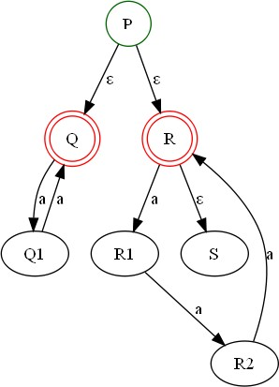
ε-Closure
ε-closure of a state
The ε-closure of the state q, denoted ECLOSE(q), is the set that
contains q, together with all states that can be reached starting at q by following only ε-transitions.
In the example:
ECLOSE(P) ={P,Q,R,S}
ECLOSE(R)={R,S}

Slide 19
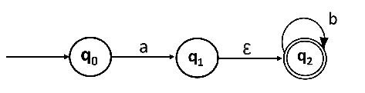
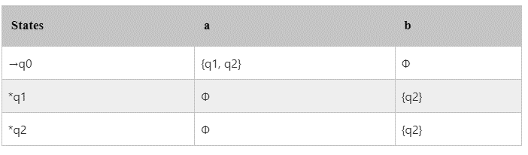
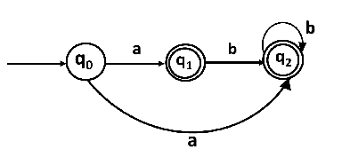
ε-Elimination
Convert the following NFA with ε to NFA without ε.

Slide 20
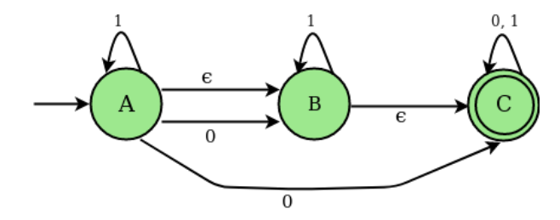
Convert NFA-ɛ to NFA

Slide 21
Regular Expressions
Regular expression ("regex"): describes a pattern of text
can test whether a string matches the expr's pattern
can use a regex to search/replace characters in a string
very powerful, but tough to read
Regular expressions occur in many places:
text editors (TextPad) allow regexes in search/replace
languages: JavaScript; Python
Unix/Linux/Mac shell commands (grep, sed, find, etc.)
https://www.w3schools.com/js/js_regexp.asp
https://www.w3schools.com/python/python_regex.asp

Slide 22
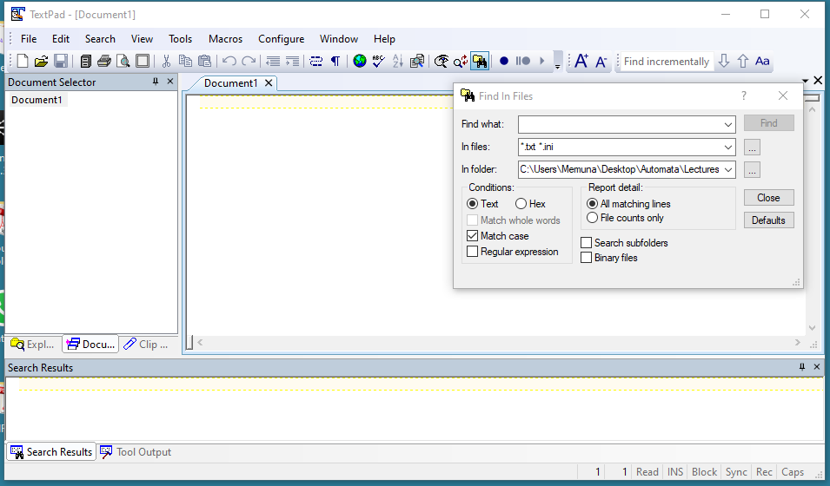
TextPad

Slide 23
Example
/abc/
a regular expression literal in JS is written as /pattern/
the simplest regexes simply match a given substring
the above regex matches any line containing "abc"
YES : "abc", "abcdef", "defabc", ".=.abc.=."
NO : "fedcba", "ab c", "AbC", "Bash", ...
. (a dot) matches any character except \n
/.oo.y/ matches "Doocy", "goofy", "LooPy", ...

Slide 24
RE’s: Introduction
The language accepted by finite automata can be easily described by simple expressions called Regular Expressions. It is the most effective way to represent any language.
The languages accepted by some regular expression are referred to as Regular languages.
A regular expression can also be described as a sequence of pattern that defines a string.
In a regular expression, x* means zero or more occurrence of x. It can generate {ɛ, x, xx, xxx, xxxx, .....}
What about x⁺ ?
It means one or more occurrence of x. It can generate {x, xx, xxx, xxxx, .....}

Slide 25
Examples
Example 1:
Write the regular expression for the language accepting all combinations of a's, over the set ∑ = {a}
Solution:
All combinations of a's means a may be zero, single, double and so on. If a is appearing zero times, that means a null string. That is we expect the set of {ε, a, aa, aaa, ....}. So we give a regular expression for this as:
R = a*

Slide 26
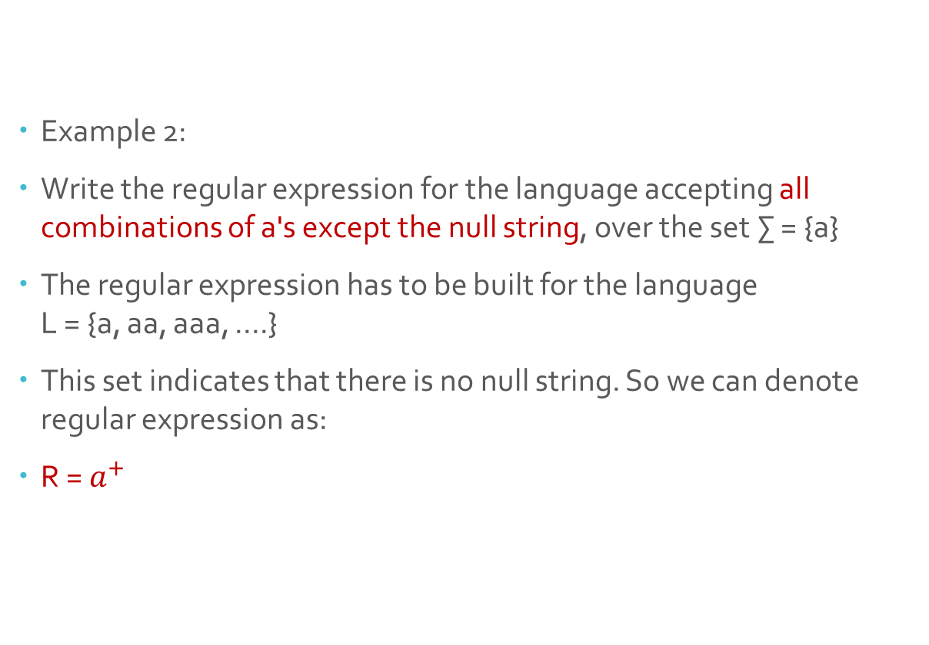
Cont…
Example 2:
Write the regular expression for the language accepting all combinations of a's except the null string, over the set ∑ = {a}
The regular expression has to be built for the language L = {a, aa, aaa, ....}
This set indicates that there is no null string. So we can denote regular expression as:
R = $a^{+}$

Slide 27
Cont…
Example 3
Write the regular expression for the language accepting all the string containing any number of a's and b's.
r.e. = (a + b)*
This will give the set as L = {ε, a, aa, b, bb, ab, ba, aba, bab, .....}, any combination of a and b.
The (a + b)* shows any combination with a and b even a null string.

Slide 28
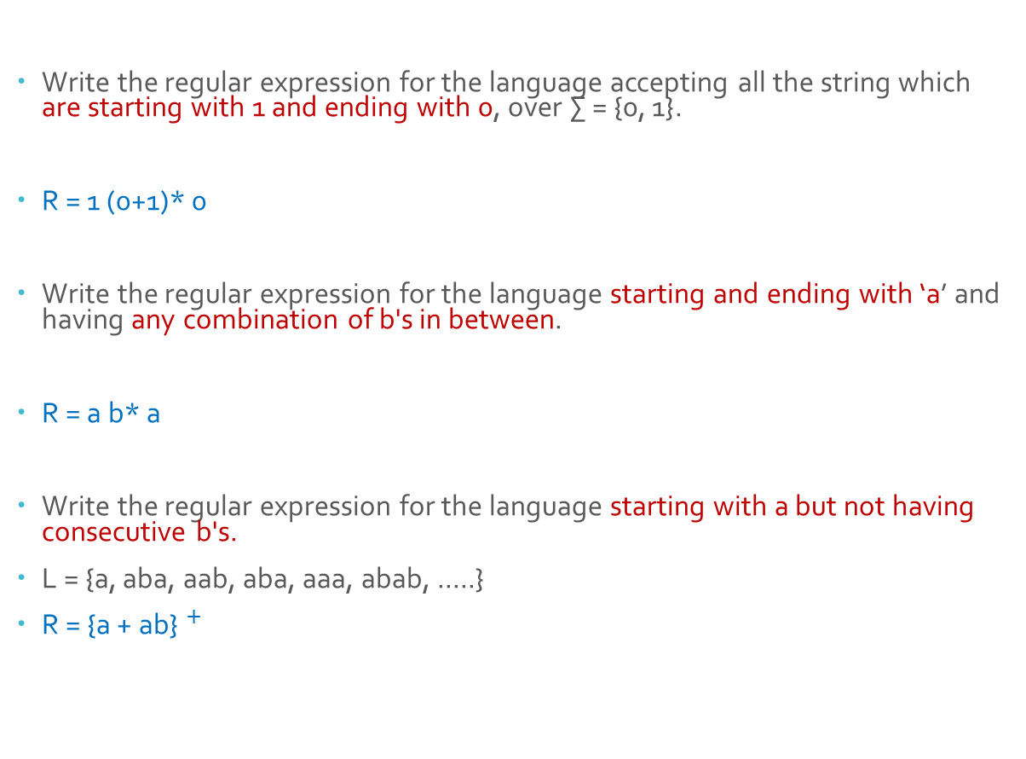
Cont…
Write the regular expression for the language accepting all the string which are starting with 1 and ending with 0, over ∑ = {0, 1}.
R = 1 (0+1)* 0
Write the regular expression for the language starting and ending with ‘a’ and having any combination of b's in between.
R = a b* a
Write the regular expression for the language starting with a but not having consecutive b's.
L = {a, aba, aab, aba, aaa, abab, .....}
R = {a + ab}$^{+}$

Slide 29
Cont…
Write the regular expression for the language accepting all the string in which any number of a's is followed by any number of b's is followed by any number of c's.
L={aaabbc, abc, abbccc…}
R = a* b* c*
Write the regular expression for the language over ∑ = {0} having even length of the string.
L = {ε, 00, 0000, 000000, ......}
R = (00)*

Slide 30
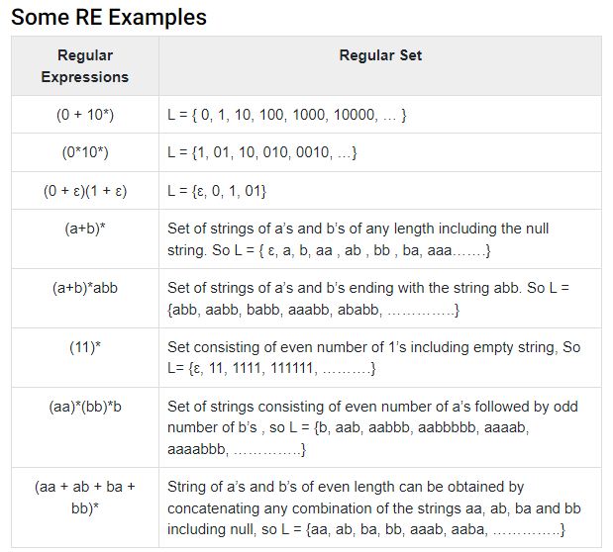
Examples

Slide 31
DFA to RE State Elimination Method
This method involves the following steps in finding the regular expression for any given DFA-
If there exists any incoming edge to the initial state, then create a new initial state having no incoming edge to it.
If there exists multiple final states in the DFA, then convert all the final states into non-final states and create a new single final state.
If there exists any outgoing edge from the final state, then create a new final state having no outgoing edge from it.
a) Eliminate all the intermediate states one by one.
These states may be eliminated in any order.
b) Only an initial state going to the final state will be left.

Slide 32
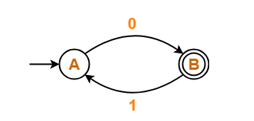
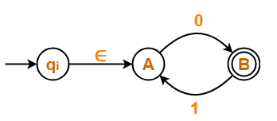
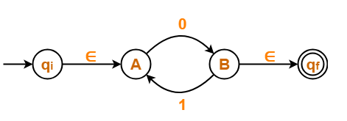
Example 1
DFA
Step 1
Step 3
There is a path going from state q_{i} to state B via state A.
So, after eliminating state A, we put a direct path from state q_{i} to state B having cost ∈.0 = 0
There is a loop on state B using state A.
So, after eliminating state A, we put a direct loop on state B having cost 1.0 = 10.

Slide 33
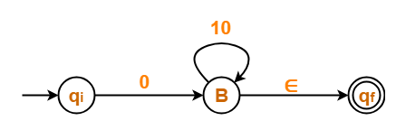

Cont…
Step 4 (a)
There is a path going from state q_{i} to state q_{f} via state B.
So, after eliminating state B, we put a direct path from state q_{i} to state q_{f} having cost 0.(10)*.∈ = 0(10)*
Step 4 (b)

Slide 34
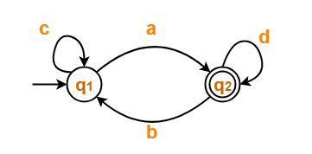
Find RE for this DFA

